Slide 1
Agentic AI Hackathon: Building Intelligent Agents with IBM Granite and LangFlow

Slide 2



Name of the team:APEX
Details of Team members
TEAM MEMBER NAME | Recent Passport Photo | Email ID | Phone number [WhatsApp]
Yashas A |  | yash8narayan@gmail.com | 9900820229
Shreyas B |  | shreyasb414@gmail.com | 9901181721
Deepthi A Kumar |  | deepthik741@gmail.com | 7760479859

Slide 3
Problem statement
Heathcare : AI-Based Preventive Health Risk Assessment System
The Challenge
Preventive healthcare can be overwhelming, as individuals often struggle with:
Information gaps – Health data such as medical history, lifestyle habits, and basic vitals are scattered and not analyzed together.
Personalization gaps – Generic health advice does not reflect individual age, BMI, habits, or risk profiles.
Unreliable sources – Users encounter inconsistent or non-verified health information instead of evidence-based guidelines.
Dynamic health conditions – Risk factors change continuously due to stress, diet, activity levels, and environment.
Lack of intelligent assistance – Without an explainable, trustworthy AI system, users cannot clearly understand their risk factors or preventive actions.
Without a reliable, IBM-powered and Langflow-based AI assistant, individuals spend time managing health reactively and still make suboptimal choices, leading to delayed risk detection, higher healthcare costs, poor lifestyle decisions, and reduced long-term well-being.

Slide 4
Proposed solution
We propose a secure, explainable, and evidence-driven AI system that enables proactive healthcare by predicting potential health risks and delivering personalized, preventive guidance before symptoms appear.
Solution Overview
The system is designed as a modular AI pipeline using Langflow, integrated with IBM watsonx services, and operates in four intelligent layers:
1. Data Intake & Normalization
Users provide basic health inputs such as age, BMI, lifestyle habits, and vitals. IBM services ensure secure data handling, preprocessing, and standardization for reliable AI analysis.
2. Explainable Risk Analysis (Model 1)
An AI Risk Analyzer identifies key health risk factors and generates transparent, interpretable insights instead of black-box predictions.
3. Risk Classification & Preventive Intelligence (Model 2)
A Risk Classifier categorizes users into Low, Medium, or High risk levels and attaches personalized preventive guidelines such as lifestyle changes, screening reminders, and wellness actions.
4. RAG-Based Evidence Assistant (Langflow)
A Retrieval-Augmented Generation (RAG) module retrieves and grounds responses in verified health documents like WHO guidelines and government health portals to answer user questions with verified, up-to-date, and trustworthy responses and reduces hallucination.
5. Designed for secure, scalable deployment on IBM Cloud using modular AI workflows

Slide 5
Need of project
AI-Based Preventive Health Risk Assessment System
Most healthcare systems operate in a reactive mode, identifying diseases only after symptoms appear, increasing treatment cost and health risk.
Health data such as medical history, lifestyle patterns, and basic vitals remain fragmented and underutilized instead of being analyzed intelligently.
Users lack access to personalized, explainable, and trustworthy AI-driven health insights for early risk awareness.
There is a growing demand for responsible AI systems that provide evidence-based, non-diagnostic, and ethically governed health guidance.
An IBM watsonx and Langflow-based solution is needed to deliver secure, scalable, and proactive preventive healthcare for large and diverse populations.
The project is needed to shift healthcare from reactive treatment to secure, explainable, and AI-driven preventive risk assessment using IBM watsonx and Langflow.

Slide 6
End user of project
Primary End Users
General Public / Individuals People who want early awareness of potential health risks and personalized preventive guidance for better lifestyle and wellness management.
At-Risk Population Groups Users with lifestyle-related risks (stress, obesity, inactivity, family history) who benefit from early risk screening and preventive recommendations.
Secondary End Users
Healthcare Providers & Clinics To identify high-risk individuals early and prioritize preventive care, screenings, and follow-ups.
Public Health Organizations / NGOs For large-scale health risk awareness, preventive campaigns, and population-level health monitoring.
Corporate Wellness Programs Companies to promote employee health, reduce absenteeism, and improve long-term productivity.
Technology & Platform Users
Developers & Researchers To extend, customize, and improve AI pipelines using IBM watsonx and Langflow workflows.

Slide 7
Technology Used
Langflow (DataStax)
Agent – Orchestrates the AI workflow for risk analysis, classification, and response generation
Chat Input – Collects structured and unstructured user health inputs
Chat Output – Delivers explainable risk insights and preventive recommendations
IBM AI Models
IBM Granite Model (e.g., ibm-granite-3-2-8b) Used for natural language understanding, explainable reasoning, and personalized preventive guidance
IBM watsonx.ai
Hosts and manages AI models securely
Supports inference, prompt engineering, and responsible AI features
Retrieval-Augmented Generation (RAG)
Retrieves and grounds responses in verified health documents (WHO & government health portals) to reduce hallucination
IBM Cloud
Secure deployment and data handling
Scalable infrastructure for real-time health risk assessment workflows

Slide 8
Novelty and Uniqueness
Langflow-driven AI pipelines enable modular, low-code deployment and rapid scalability across clinics, communities, and wellness programs.
First platform combining GenAI, explainable risk scoring, and evidence-based RAG to deliver proactive, personalized preventive healthcare.
IBM Granite–guarded outputs ensure bias-aware, responsible, and regulation-aligned health guidance.
Trust-first architecture retrieves information only from verified sources (WHO and government health portals) to prevent misinformation.
Non-diagnostic, safety-governed AI layer ensures ethical use while empowering early health risk awareness at scale.

Slide 9
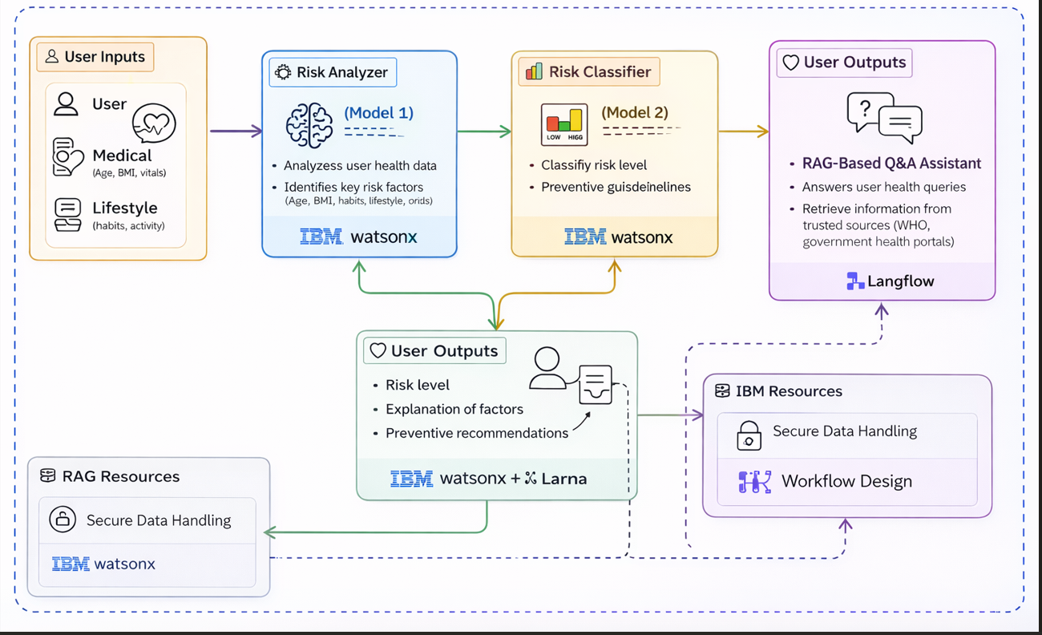
Technical flow diagram - Architecture blueprint

Slide 10
Langflow component Used
Agent – Orchestrates the AI workflow for risk analysis, classification, and response generation
Chat Input – Collects structured and unstructured user health inputs
Chat Output – Delivers explainable risk insights and preventive recommendations
IBM AI Models
IBM Granite Model (e.g., ibm-granite-3-2-8b) Used for natural language understanding, explainable reasoning, and personalized preventive guidance
IBM watsonx.ai
Hosts and manages AI models securely
Supports inference, prompt engineering, and responsible AI features
Retrieval-Augmented Generation (RAG)
Retrieves trusted medical knowledge from verified health documents like WHO and government health portals
Ensures evidence-based, up-to-date, and reliable AI responses
IBM Cloud
Secure deployment and data handling
Scalable infrastructure for real-time health risk assessment workflows

Slide 11
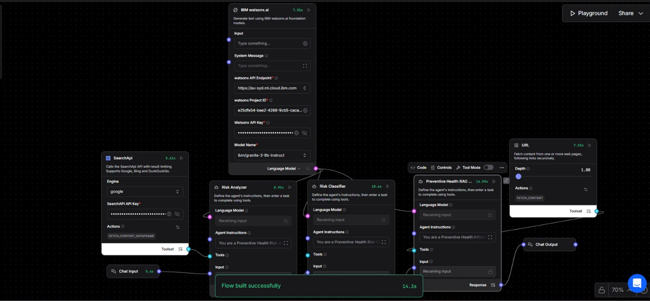
Input Screenshot 1

Slide 12
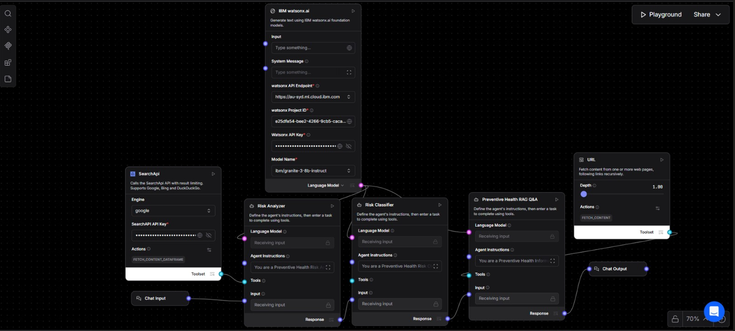
Input Screenshot 2

Slide 13
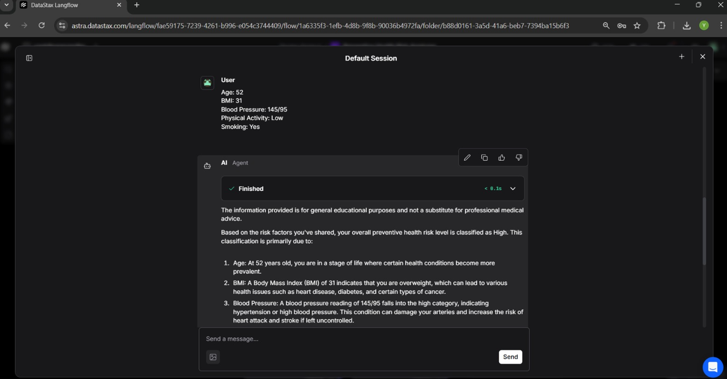
Output Screenshot 1

Slide 14
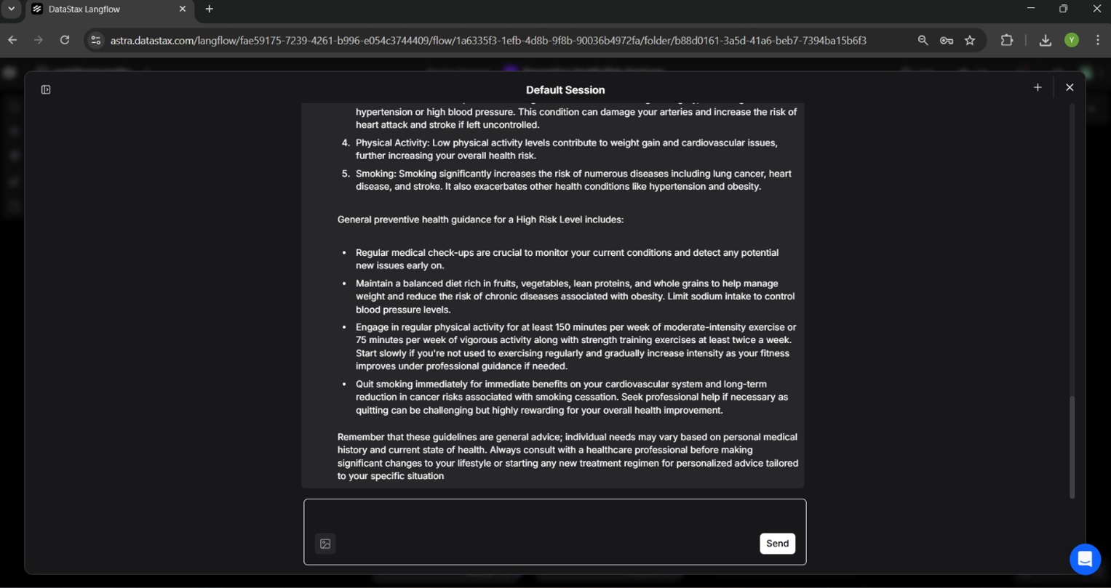
Outut Screenshot 2

Slide 15
Future Scope
Predictive Disease Modeling Extend AI models to forecast specific chronic conditions such as diabetes, cardiac risk, and hypertension using longitudinal data.
Wearable & IoT Integration Integrate smartwatches, fitness bands, and IoT health sensors for continuous, real-time risk monitoring.
Population Health Dashboards Enable healthcare providers and governments to view anonymized, region-wise health risk trends for preventive campaigns.
Multilingual & Voice-Based Access Support regional languages and voice assistants to improve accessibility in rural and underserved communities.
Clinical System Integration Connect with hospital EMR/EHR systems for seamless preventive screening and follow-up workflows.
Advanced Responsible AI Governance Implement audit trails, bias monitoring, and compliance dashboards aligned with global healthcare regulations.
Enterprise & Insurance Adoption Extend the platform for corporate wellness programs and health insurance risk prevention models.
·
·
·

Slide 16
Git Hub Link
https://github.com/yashasA9/preventive-health-risk-analyzer
·
·
·

Slide 17
References
AI-Based Risk Assessment Tools — BMC Medical Informatics and Decision Making → https://bmcmedinformdecismak.biomedcentral.com/articles/10.1186/s12911-025-02864-5
Responsible AI in Public Health — WHO News Release → https://www.who.int/europe/news/.../responsible-ai-use-can-advance-risk-communication
WHO AI Regulation Considerations → https://www.who.int/news/.../who-outlines-considerations-for-regulation-of-artificial-intelligence-for-health
Trust in AI Health Advice (TAIGHA Study) → https://arxiv.org/abs/2512.14278

Slide 18


